Slide 1
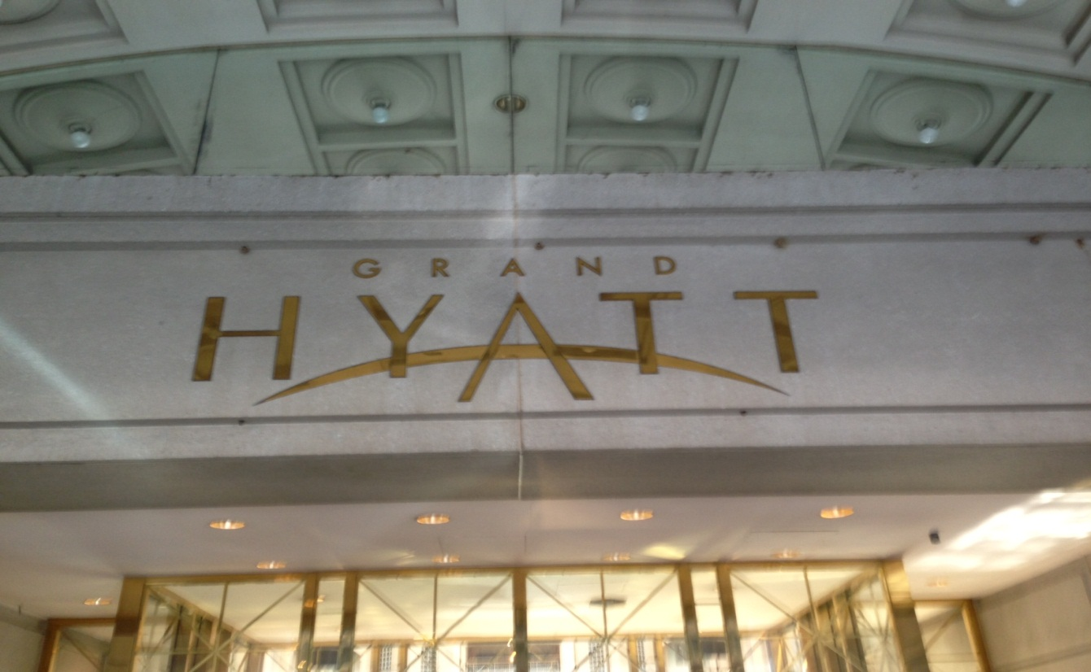
Grand Hyatt
AHU-18 replacement and AHU-16 & 17 restoration

Slide 2
AHU-18 replacement
The existing AHU-18 was approximately 30 years old and in need of replacement.
The exterior casing and internal components had deteriorated beyond the point of repair.
The existing unit was not designed to accommodate proper service and the hydronic coils had frozen and burst.
Host Properties and Southland Industries selected Air Cleaning Technologies, Inc. (Integrated Systems Division) as the replacement AHU-18 manufacturer.

Slide 3
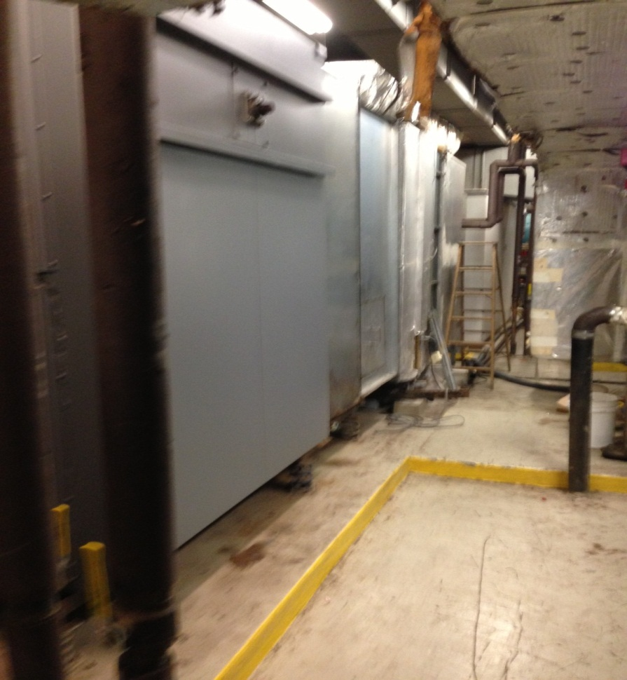
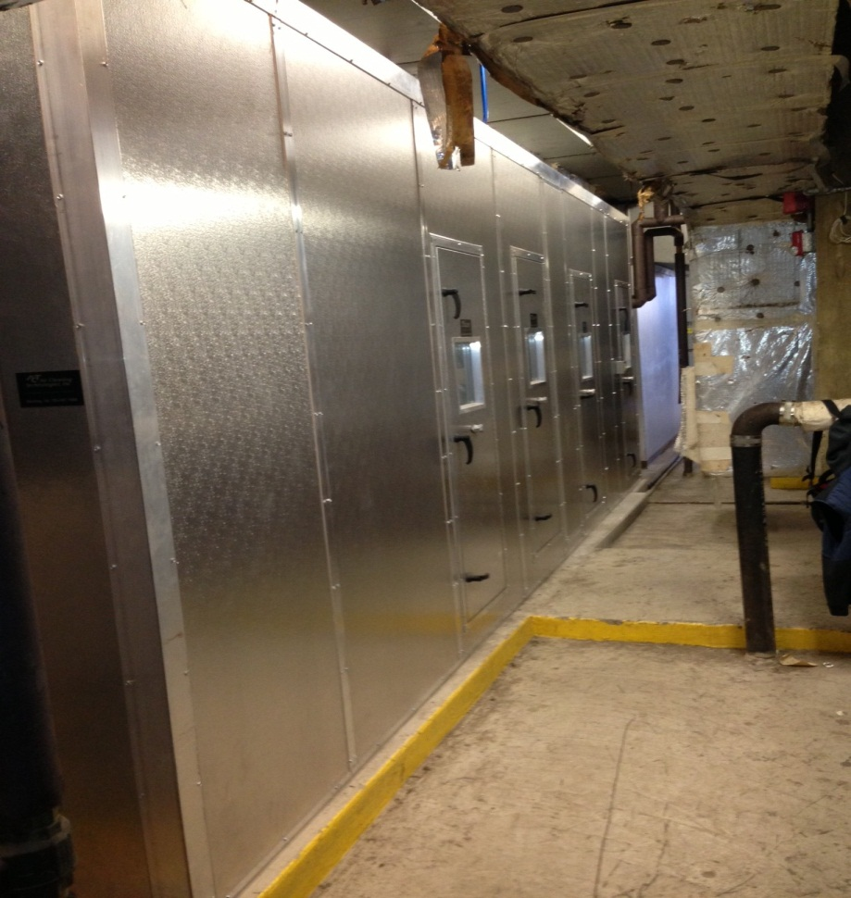
Old AHU-18
Old AHU-18 casing with single wall construction and internal insulation.
New AHU-18 casing with foam filled “no thru metal” double wall casing.

Slide 4
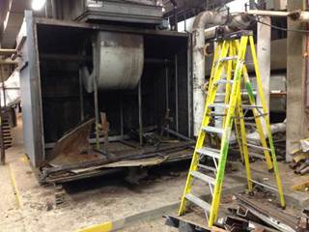
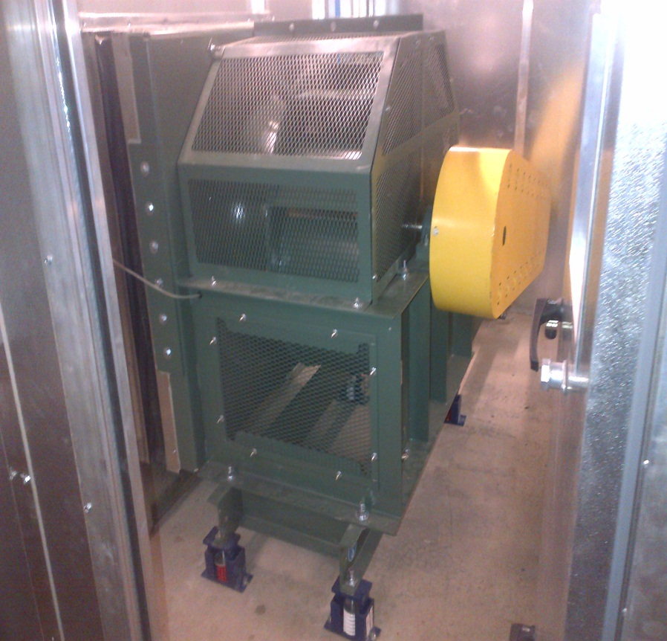
AHU-18 fans
Old DWDI fan with external isolation
New SWSI plenum fan with internal isolation

Slide 5
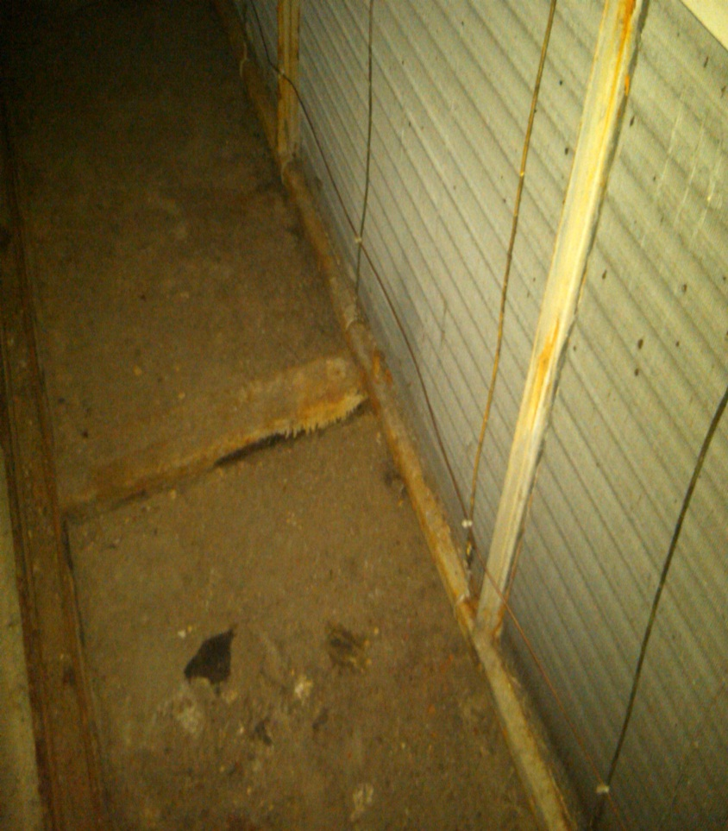
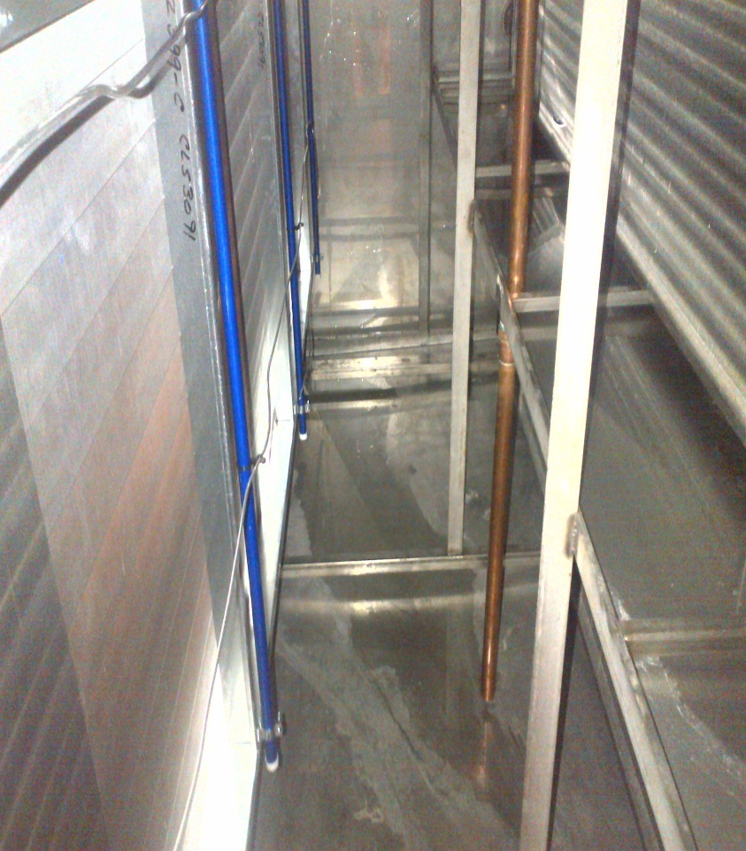
AHU-18 chilled water condensate pans
Old pans with no slope and deteriorated soft metal
New seam welded stainless steel pans with double wall sloped construction.

Slide 6
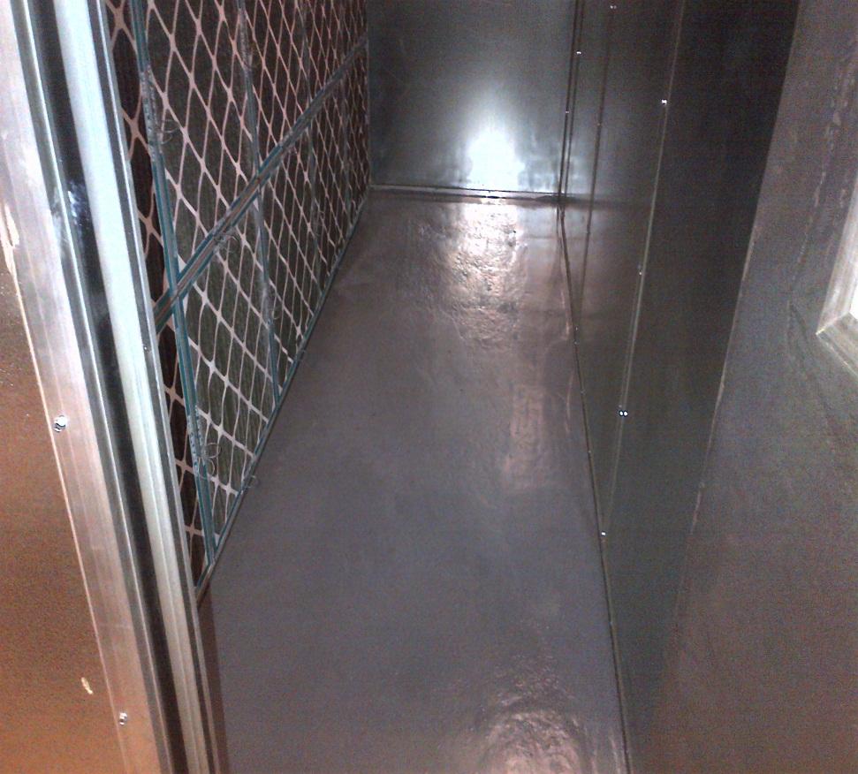
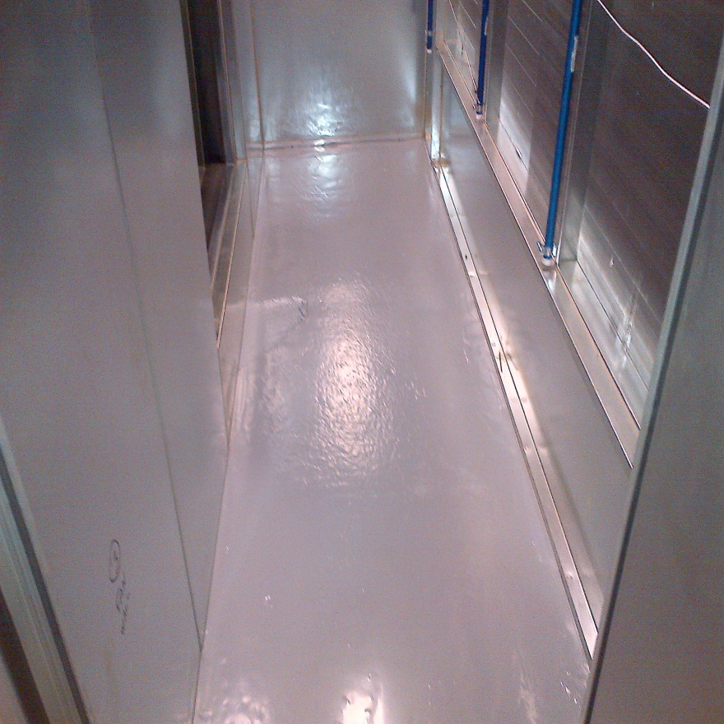
All concrete floors coated with immersion grade Belzona 5811 sealant
Filter section
Fan inlet section

Slide 7
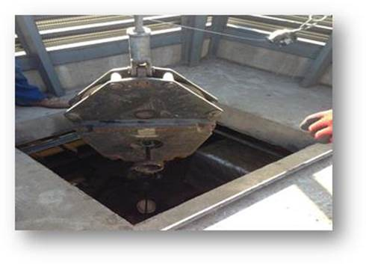
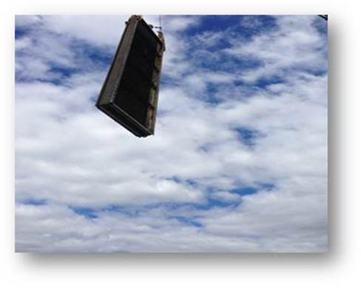
AHU-18 removal and installation
All old and new material had to be rigged through a 40” x 40” access hatch
Old coils being removed

